Slide 1
Adaptive
Basketball
Coach
Gurleen Bath, Brendan Keegan, Diana Liu, Ben Trey, Sishir Yeety
Notes:
Diana

Slide 2
Agenda
01
Introduction
02
Architectural display and user interface
03
Device setup and data collection
04
Analyzing and cleaning the data
05
Our App
06
Roadblocks and Lessons learned
Notes:
Diana

Slide 3
Introduction
Why?
How?
Who?
Goal
Ultimately we aim to provide an application that makes basketball coaching much more personalized and accessible to the player
Many people attribute a sport like basketball to innate skill, however what if we could
create a device that would provide an accessible way for more people to learn the skills required to be a successful basketball player.
We hope to combine machine learning, computer vision and digital signal processing to gain a deeper understanding of the basketball shooting process
Our app can be used by a novice basketball player who wants to learn how to make the perfect shot. Or a seasoned player like Steph Curry who needs more detailed notes on improvement and everyone in between!
Notes:
Diana

Slide 4
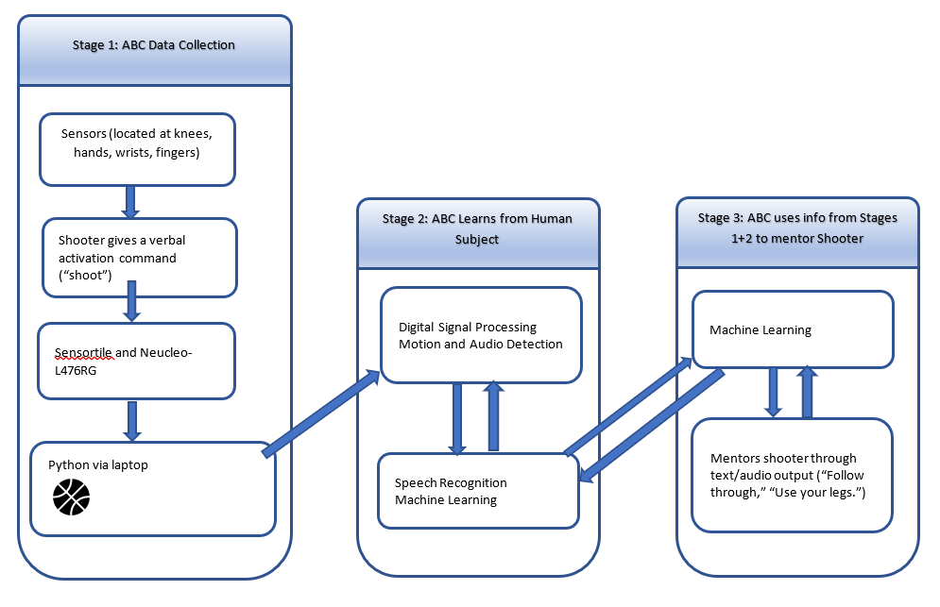
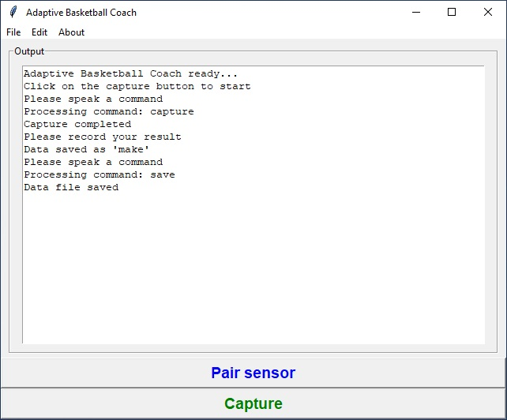
Architectural Display
Add something about UI
Notes:
Diana

Slide 5
Machine Learning
Python Libraries
pandas
blue_st_sdk
1. Data collection
2. Clustering using k-means
3. Logistic Regression
4. Model Feedback
numpy
subprocess
scikit learn
matplotlib
SciPy
Notes:
Sishir

Slide 6
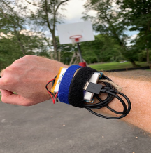
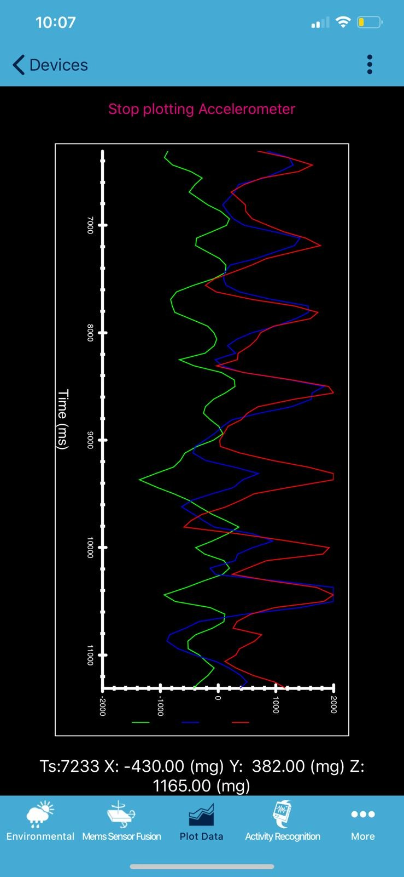
Data Collection
Connect sensor to bluetooth and download the ST BLE app on mobile device.
To keep device powered throughout the data collection we used a powerboost and lithium ion polymer 5V battery
we logged out data every time we took a shot and emailed each shot’s accelerometer and gyroscope data directly from the app as a csv.
Notes:
Gurleen

Slide 7
Analyzing and Cleaning the data
01
Looked at our raw data from the .CSV
BASKETBALL
02
The ST BLE app give users acceleration and gyroscope .csv separately. We tried different methods to combine the two files together in two different ways such as combining ALL shot data or collating individual shot data into max/min
03
Tried both methods and compared to see what runs best in our model.
Notes:
Brendan

Slide 8
Logistic Regression
Normalization (scale all variables between 0 and 1)
Standardization (transform data to have a mean of 0 and stdev of 1
Cross validation
Class imbalances
Hyperparameter Tuning using GridSearchCV. Logreg has one parameter “C” that tends to overfit most of the time
Using sklearn’s logistic regression, the model had an initial accuracy score of 61%
Conclusion
Finally, a combination of balancing the classes, 50-fold cross validation, and multinomial logistic regression improved the accuracy score to 63%
LogisticRegressionCV(Cs=10,cv=50, class_weight='balanced', max_iter=500, multi_class='multinomial')
Notes:
Sishir

Slide 9
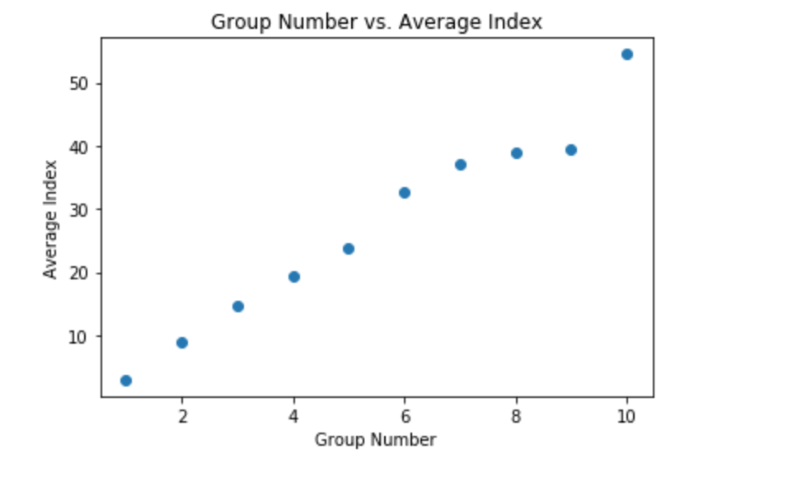
Clustering Using K Means
we collected some data by taking 5 shots and then taking one step back did this from about 3 ft - 20 ft from the hoop.
We were curious about if we could use machine learning/ai to group these like shots together
Used 10 clusters. Why? because for a basketball shot you can actually have a lot of error but still make the shot. Therefore giving every two feet their own individual cluster seems reasonable.
To the left is a graph of the results of the K means cluster, the average position of each group was plotted.
The data was almost evenly distributed.
Therefore it was actually accurately grouping the shots in roughly the right position. K means does a great job of figuring out how far you are from the hoop.
Content Here
Get a modern PowerPoint Presentation that is beautifully designed.
Notes:
Ben

Slide 10
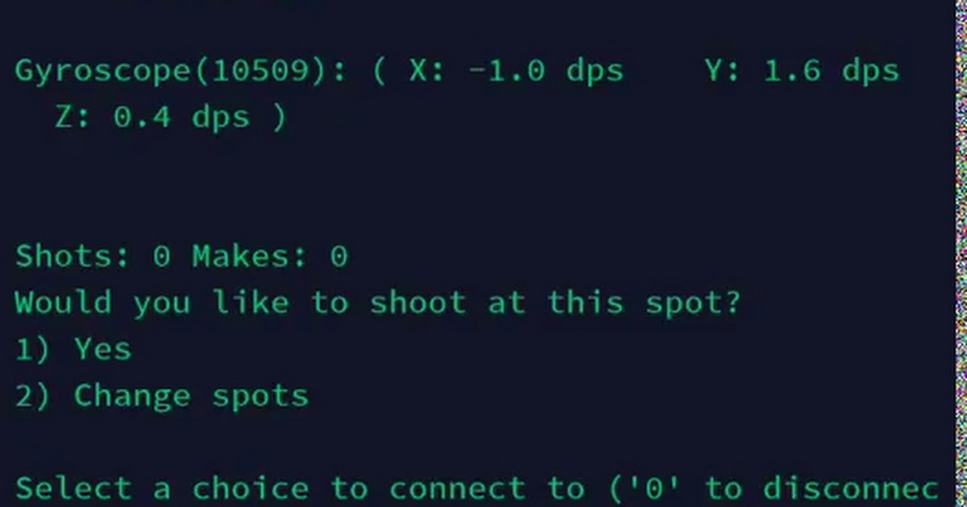
Our Application
Takes real time data using the blue_st_sdk module.
Records the data and updates the model after every shot. Adapts to different shooters and techniques.
Models the response the user gives to the app and uses the data to give individualized instruction.
Begins making predictions after very samples.
Digital Signal Processing
User Interface (UI)
We built and used uniquely placed sensors that transmitted with BLE.
Uses speech recognition to initiate our program; Includes a user-friendly interface meant for Android/IOS app.
Main Program
Analysis
Python toward Android/IOS app; Collects the data to analyze and provide mentorship
Uses machine learning, numpy, scikit-learn in Python for modeling the data and mentoring the player
Notes:
Ben-top part is Ben’s work; Bottom part Ben gives brief review of the team’s full efforts in summary and how it all comes together

Slide 11
Roadblocks and Lessons Learned
Bluetooth, Python for UI, and Sensor Synchronization
Bluetooth
01
We hit some early snags in the Bluetooth code, but with perseverance and guidance from course staff were able to find our way through
Python and the UI
02
We found while Python has many strengths it may not be ideal for an Android/IOS app. Perseverance is key and we found a compromise that still benefits from Python
Sensor Synchronization
03
We hoped to synchronize data collection on several sensor placements. While we did not achieve this milestone with the time we had we were pleased to collect data from various placements
BASKETBALL
TOURNAMENT
Notes:
Brendan Using the momentum from your legs gets better shots

Slide 12
Thank You
Treaty Bio

